Slide 1
Introduction to Applied
Spatial Econometrics
Attila Varga
DIMETIC Pécs, July 3, 2009

Slide 2
Prerequisites
Basic statistics (statistical testing)
Basic econometrics (Ordinary Least Squares and Maximum Likelihood estimations, autocorrelation)

Slide 3
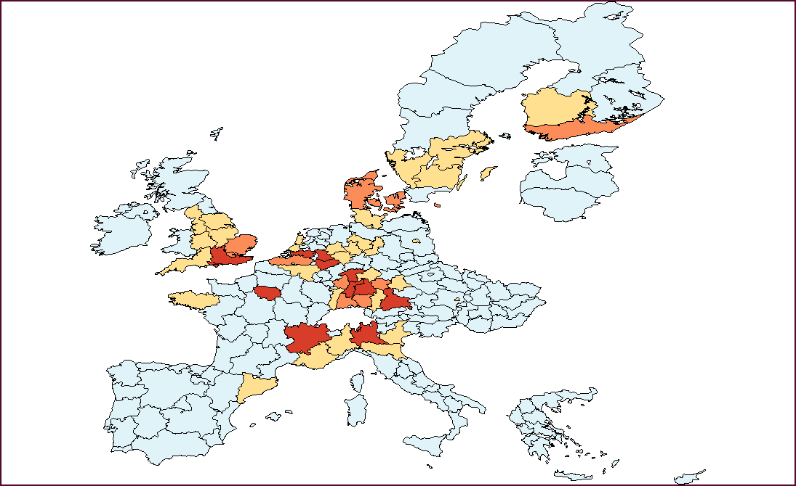
EU Patent applications 2002

Slide 4
Outline
Introduction
The nature of spatial data
Modelling space
Exploratory spatial data analysis
Spatial Econometrics: the Spatial Lag and Spatial Error models
Specification diagnostics
New developments in Spatial Econometrics
Software options

Slide 5
Spatial Econometrics
„A collection of techniques that deal with the peculiarities caused by space in the statistical analysis of regional science models”
  Luc Anselin (1988)

Slide 6
Increasing attention towards Spatial Econometrics in Economics
Growing interest in agglomeration economies/spillovers – (Geographical Economics)
Diffusion of GIS technology and increased availability of geo-coded data

Slide 7
The nature of spatial data
Data representation: time series („time line”) vs. spatial data (map)
Spatial effects:
spatial heterogeneity
spatial dependence

Slide 8
Spatial heterogeneity
Structural instability in the forms of:
  Non-constant error variances (spatial heteroscedasticity)
  Non-constant coefficients (variable coefficients, spatial regimes)

Slide 9
Spatial dependence
(spatial autocorrelation/spatial association)
In spatial datasets „dependence is present in all directions and becomes weaker as data locations become more and more dispersed” (Cressie, 1993)
Tobler’s ‘First Law of Geography’: „Everything is related to everything else, but near things are more related than distant things.” (Tobler, 1979)

Slide 10
Spatial dependence
(spatial autocorrelation/spatial association)
Positive spatial autocorrelation: high or low values of a variable cluster in space
Negative spatial autocorrelation: locations are surrounded by neighbors with very dissimilar values of the same variable

Slide 11
EU Patent applications 2002

Slide 12
Spatial dependence
(spatial autocorrelation/spatial association)
Dependence in time and dependence in space:
  Time: one-directional between two observations
  Space: two-directional among several observations

Slide 13
Spatial dependence
(spatial autocorrelation/spatial association)
Two main reasons:
  Measurement error (data aggregation)
  Spatial interaction between spatial units

Slide 14
Modelling space
Spatial heterogeneity: conventional non-spatial models (random coefficients, error compontent models etc.) are suitable
Spatial dependence: need for a non-convential approach

Slide 15
Modelling space
Spatial dependence modelling requires an appropriate representation of spatial arrangement
Solution: relative spatial positions are represented by spatial weights matrices (W)

Slide 16
Modelling space
1. Binary contiguity weights matrices
- spatial units as neighbors in different orders (first, second etc. neighborhood classes)
- neighbors:
- having a common border,
or
- being situated within a given distance band
2. Inverse distance weights matrices

Slide 17
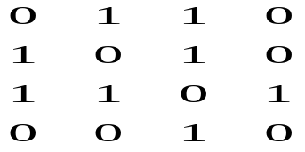
Modelling space
Binary contiguity matrices (rook, queen)
w_{i,j} = 1 if i and j are neighbors, 0 otherwise
Neighborhood classes (first, second, etc)
W =

Slide 18
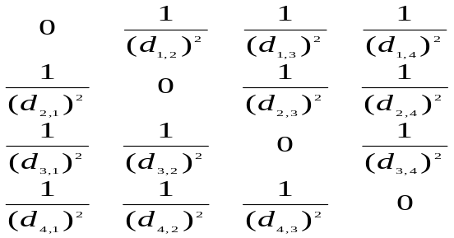
Modelling space
Inverse distance weights matrices
W =

Slide 19
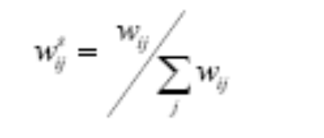
Modelling space
Row-standardization:
Row-standardized spatial weights matrices:
- easier interpretation of results (averageing of values)
- ML estimation (computation)

Slide 20
Modelling space
The spatial lag operator: Wy
  is a spatially lagged value of the variable y
  In case of a row-standardized W, Wy is the average value of the variable:
    in the neighborhood (contiguity weights)
    in the whole sample with the weight decreasing with increasing distance (inverse distance weights)

Slide 21
Exploratory spatial data analysis
Measuring global spatial association:
  The Moran’s I statistic:
a) I = N/S₀ [Σ_{i,j} w_{ij} (x_{i} -μ)(x_{j} - μ) / Σ_{i}(x_{i} -μ)²]
normalizing factor: S₀ =Σ_{i,j} w_{ij}
(w is not row standardized)
b) I* = Σ_{i,j} w_{ij} (x_{i} -μ)(x_{j} - μ) / Σ_{i}(x_{i} -μ)²
(w is row standardized)

Slide 22
Global spatial association
Basic principle behind all global measures:
- The Gamma index
Γ = Σ_{i,j} w_{ij} c_{ij}
  Neighborhood patterns and value similarity patterns compared

Slide 23
Global spatial association
Significance of global clustering: test statistic compared with values under H₀ of no spatial autocorrelation
- normality assumption
- permutation approach

Slide 24
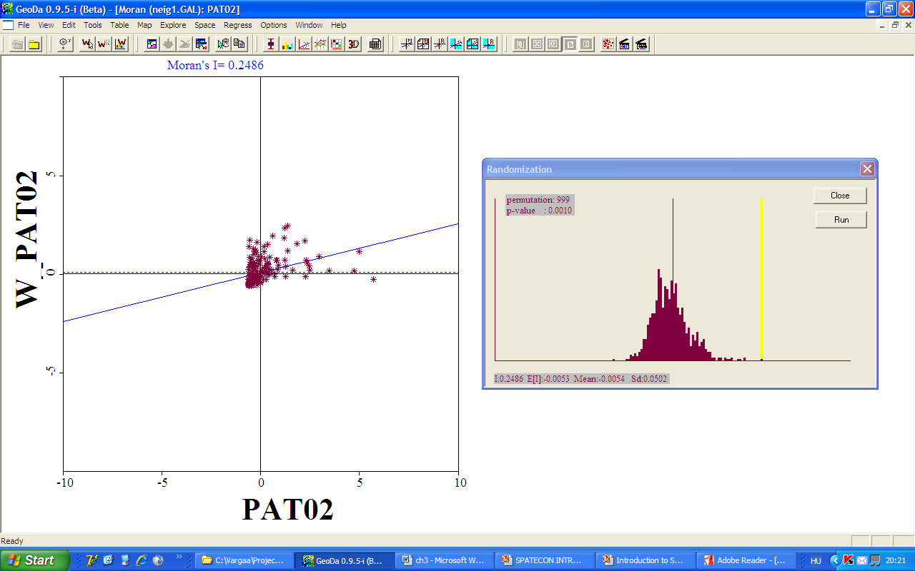

Slide 25
Local indicatiors of spatial association (LISA)
The Moran scatterplot
idea: Moran’s I is a regression coefficient of a regression of Wz on z when w is row standardized:
I=z’Wz/z’z
(where z is the variable in deviations from the mean)
- regression line: general pattern
- points on the scatterplot: local tendencies
- outliers: extreme to the central tendency (2 sigma rule)
- leverage points: large influence on the central tendency (2 sigma rule)

Slide 26
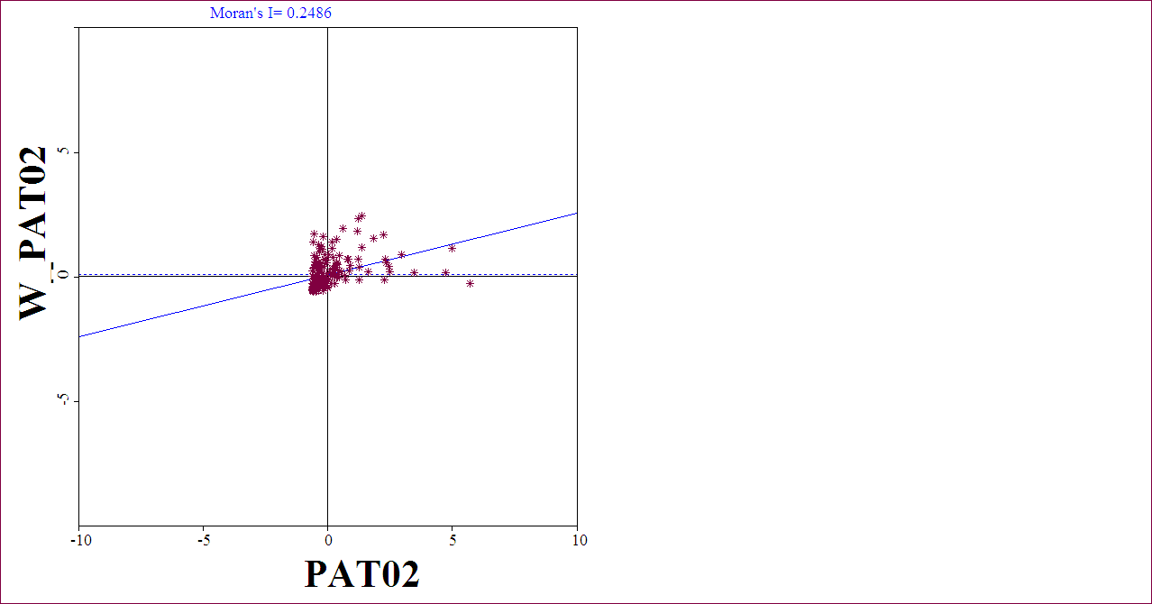
Moran scatterplot

Slide 27
Local indicators of spatial association (LISA)
B. The Local Moran statistic
I_{i} = z_{i}Σ_{j}w_{ij}z_{j}
  significance tests: randomization approach

Slide 28
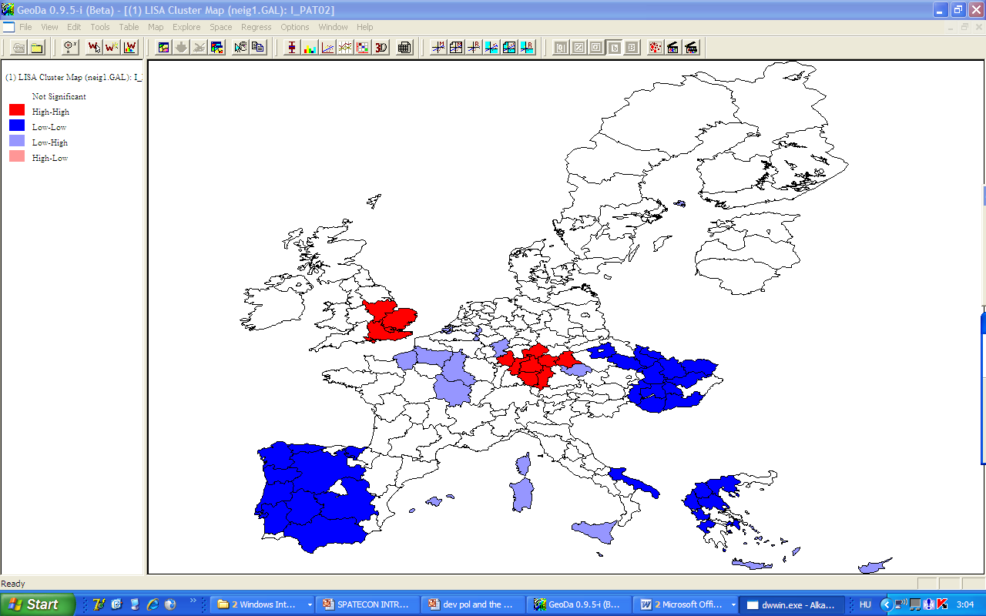

Slide 29
Spatial Econometrics
The spatial lag model
The spatial error model

Slide 30
The spatial lag model
Lagged values in time: y_{t-k}
Lagged values in space: problem (multi-oriented, two directional dependence)
  Serious loss of degrees of freedom
Solution: the spatial lag operator, Wy

Slide 31
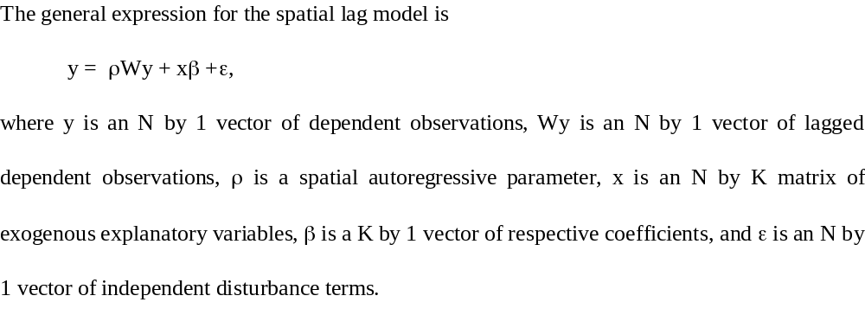
The spatial lag model

Slide 32
The spatial lag model
Estimation
  Problem: endogeneity of wy (correlated with the error term)
  OLS is biased and inconsistent
  Maximum Likelihood (ML)
  Instrumental Variables (IV) estimation

Slide 33
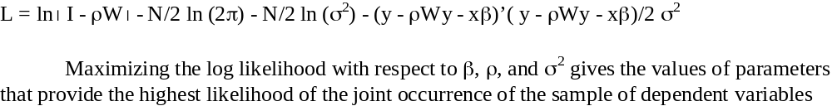
The spatial lag model
ML estimation: The Log-Likelihood function

Slide 34
The Spatial Lag model
IV estimation (2SLS)
  Suggested instruments: spatially lagged exogenous variables

Slide 35
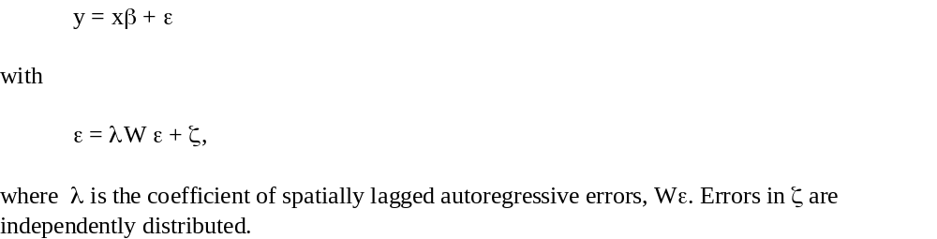
The Spatial Error model

Slide 36
The Spatial Error model
OLS: unbiased but inefficient
ML estimation

Slide 37
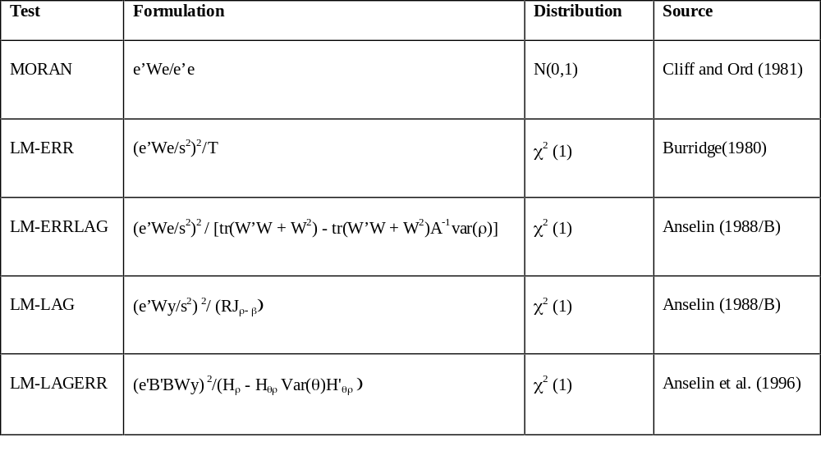
Specification tests

Slide 38
Steps in estimation
Estimate OLS
Study the LM Error and LM Lag statistics with ideally more than one spatial weights matrices
The most significant statistic guides you to the right model
Run the right model (S-Err or S-Lag)

Slide 39
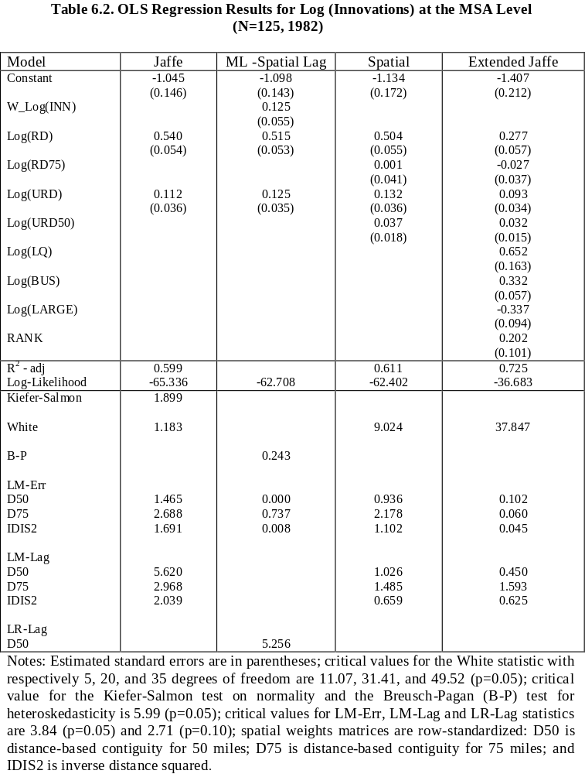
Example: Varga (1998)

Slide 40
Spatial econometrics:
New developments
Estimation: GMM
Spatial panel models
Spatial Probit, Logit, Tobit

Slide 41
Study materials
Introductory:
  Anselin: Spacestat tutorial (included in the course material)
  Anselin: Geoda user’s guide (included in the course material)
Advanced:
  Anselin: Spatial Econometrics, Kluwer 1988

Slide 42
Software options
GEODA – easiest to access and use
SpaceStat
R
Matlab routines

